Slide 1

Turning to the Functional side (Using C# and F#)
Phil Trelford
http://trelford.com/blog @ptrelford
Tomas Petricek
http://tomasp.net/blog @tomaspetricek

Slide 2
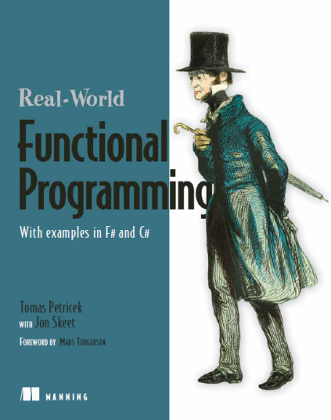
About Us
Tomas
Author of F# book for C# programmers
Worked with the F# team at Microsoft
First blogged about F# in May 2006
Phil
Software Developer and Architect
Worked on first F# applications at Microsoft
Co-organizer of London F# User Group

Slide 3
Tutorial
Goals
Introduce Functional Concepts with F# and C#
Non-goals
Provide in-depth understanding
Mass conversion to functional programming cult
Sell books

Slide 4
Jargon Buster
OO = Object Orientated
FP = Functional Programming
Lambda = Anonymous Function
DSL = Domain Specific Language

Slide 5
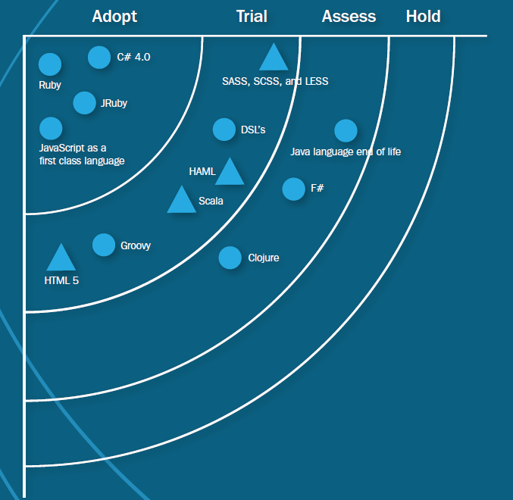
Thoughtworks Technology Radar 2011
Notes:
Thoughtworks technlogy radar: http://www.thoughtworks.com/radar/
Image source: http://www.thoughtworks.com/sites/www.thoughtworks.com/files/files/tw-radar-april-2010.pdf
See also: http://qconlondon.com/london-2010/file?path=/qcon-london-2010/slides/AmandaLaucher_and_JoshGraham_TheStateOfTheArtNET12MonthsOfThingsToLearn.pdf

Slide 6
Languages circa 2010
Functional
Dynamic
Python
Ruby
OO
C++
C#
F#
Scala
Java
Clojure
Erlang
Groovy
JavaScript
Objective- C
Notes:
http://en.wikipedia.org/wiki/Dynamic_programming_language

Slide 7
Languages go multi-paradigm
Functional
Dynamic
OO
Notes:
http://en.wikipedia.org/wiki/Comparison_of_programming_languages
Definitions of FP, OO and Dynamic

Slide 8
F# is a mix of
Python
OCaml
C#
F#
Notes:
Python = light, C# = OO, OCaml = Functional

Slide 9
What is F#?
F# is multi-paradigm language, that is:
Functional
Declarative
Object Orientated
Imperative
.Net language with VS integration

Slide 10
Running F#
Visual Studio 2010
Visual Studio Shell + F#
MonoDevelop on Linux and Mac
F# Compiler + Emacs etc.
In your browser
Notes:
http://tryfsharporg.cloudapp.net/
http://trelford.com/MissileCommand.fsx

Slide 11


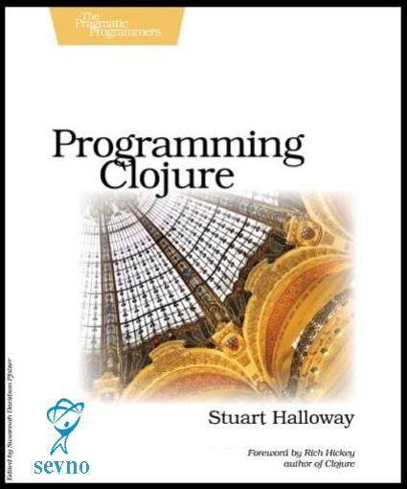
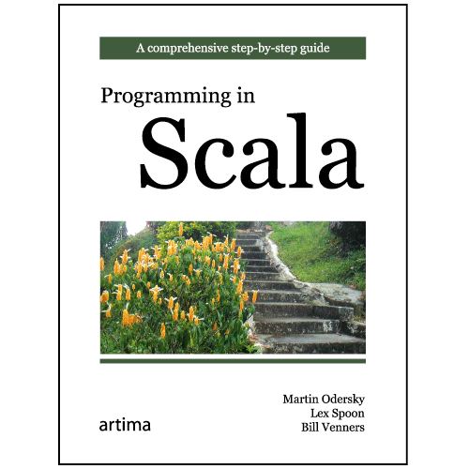
FP hits mainstream
Visual Studio gets F#
C# gets LINQ, lambdas, etc
C++ gets lambdas
JVM gets Clojure & Scala

Slide 12
Writing queries with LINQ
Query syntax supported in C# 3.0
Functional programming concepts
Declaratively describes “what” not “how”
Written as single expression
var q =
from p in db.Products
where p.UnitPrice > 75.0M
select String.Format("{0} - ${1}",
p.ProductName, p.UnitPrice);

Slide 13
Graphical User Interface Frameworks
XUL (Mozilla), Glade (Gtk), XAML (.NET)
Functional programming concepts
Compose button with ellipse inside
Specify behavior declaratively
<Button x:Name="greenBtn" Background="Black">
<Ellipse Width="75" Height="75" Fill="LightGreen" />
</Button>
<DoubleAnimation Storyboard.TargetName="greenBtn"
Storyboard.TargetProperty="(Canvas.Left)"
From="0.0" To="100.0" Duration="0:0:5" />

Slide 14
Specifying financial contracts in F#
Functional programming concepts
Declaratively describes “what” not “how”
Written as single expression
Composed from small number of primitives
let march day = DateTime(2011, 3, day)
let itTrades =
(sell (tradeAt (march 15) "GOOG" 500)) $
(between (march 10) (march 19) (trade "MSFT" 1000))
let tradeAt date what amount =
between date date (trade what amount)

Slide 15
Code Samples
1: // Declare a local value (inferred type is string)
2: let world = "world"
3:
4: // Using '%s' format specifier to include string parameter
5: printfn "Hello %s!" world

Slide 17
Functional data structures
A way of thinking about problems
Model data using composition of primitives
Tuple
Combine two values of different types
Discriminated Union
Represents one of several options
List
Zero or more values of the same type

Slide 18

Tuples: Containers for a few different things

Slide 19
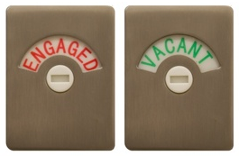
Discriminated Unions: Exclusive alternatives

Slide 20
Representing event schedule
Object-oriented way
Easy to add new cases
Hard to add new functions
Functional way
Easy to add new functions
Hard to add new cases
Good thing about F# and Scala – you can use both!

Slide 21

List: Heads and Tails

Slide 22
Map Reduce
MapReduce is a patented software framework introduced by Google to support distributed computing on large data sets on clusters of computers.
Functional design scales extremely well!

Slide 23
Domain Modelling
Retail Domain -> Testing

Slide 24

Checkout application workflow
Think of a simple while loop
Implement…
Mutable field to keep the state and event handlers?
Asynchronous while loop in F#

Slide 25
Asynchronous and concurrent programming
Asynchronous GUI in Checkout example
Single-threaded thanks to Async.StartImmediate
Easy way to encode control flow
Parallel programming
Workflows are non-blocking computations
Run workflows in parallel with Async.Parallel
Concurrent programming
Compose application from (thousands of) agents
Agents communicate using messages

Slide 26
Wild Card Filler
Silverlight mini-samples

Slide 27
Summary
FP is already in the mainstream
FP languages are ready
Start small, go big
Language Orientated Programming
Exploratory and Scripting
Asynchronous & Concurrency
Technical Computing
Testing

Slide 28
Summary
Don’t underestimate
the power of the
functional side

Slide 29
Meet the F#ers
@rickasaurus
@tomaspetricek
@dmohl

Slide 30
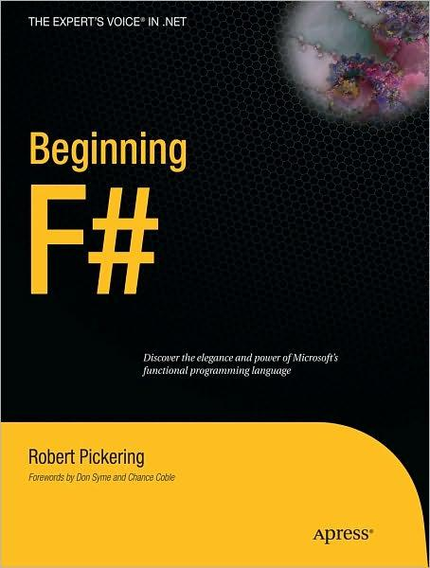
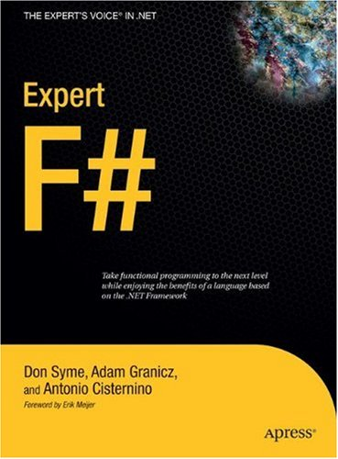
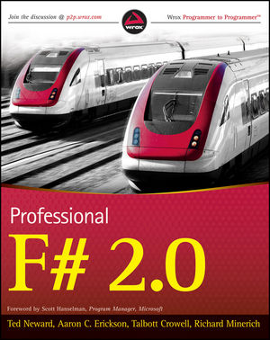
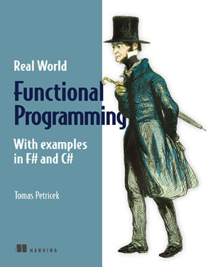


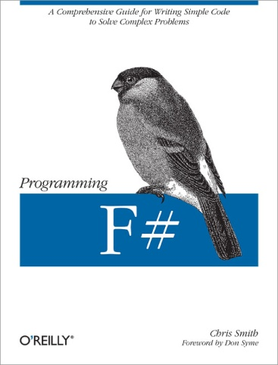
F# Books

Slide 31

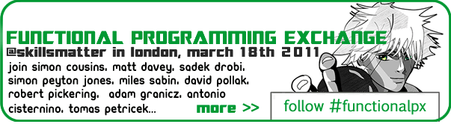
On the horizon
Next Meet: In the brain of
Rob Pickering on March 16th

Slide 32
Q & A
http://Fsharp.net
http://fssnip.net
http://tomasp.net/blog
http://trelford.com/blog

